Slide 1
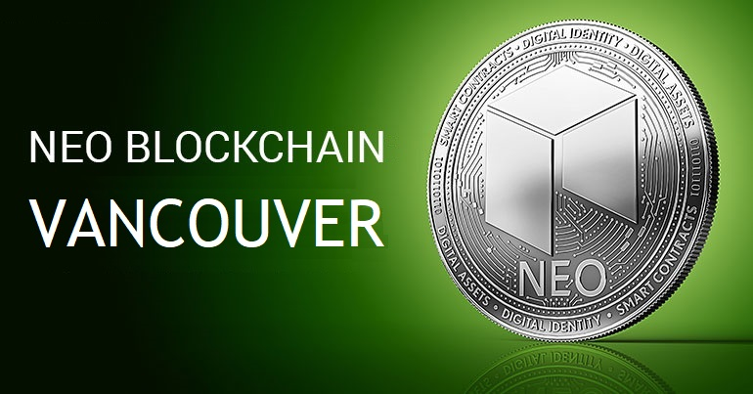
NEO Blockchain TORONTO
Welcome Neoxplorers!
“Genesis Block 0” Meetup – March 15, 2018
https://www.meetup.com/NEO-Blockchain-Vancouver/
neotoronto@outlook.com

Slide 2
What You’ve Asking to See/Hear/Learn About
How to create smart contract on Neo, what will be the oracle (is there a similar setup with Neo like it is with etherium?)
Sidechains, Trinity, Interledger
I would like to know more about future plans
NEO future
jobs
Dapp development on NEO
The future of NEO and how quickly dapps will begin to appear on the platform.
How is NEO different, what problem does it solve and how. Thanks in advance
how to build smart contracts
Getting into blockchain development
How does NEO compare to Ethereum, ICON and Qtum with respect to both technical goals and end-vision. More generally, where does NEO see itself fitting in the ecosystem among other platform blockchains?
How what Dapps are being developed on the NEO platform from Local area and how they can be supported.
Road Map regarding the future
Intro to neo
NEO ICOs
Decentralization and large-scale adoption.
Python smart contract development
How NEO will be implemented in the future. What sort of benefits can they bring economically. Why go with NEO versus other blockchain solutions?
Information on NEO based ICOs, also info on trinity and NEX exchange! Thanks!
resources, local projects or teams
Elastos
Let's start at the beginning.
Am a .NET guy too. Getting started on development
Technical aspects of programming for Neo, coding, deployment
Understanding of NEO Blockchain
Neo origins
NEO Smart Contract and ICOs
Technical details
NEO Development

Slide 3
NEO Themes You’ve Asked About – Thank you!
Distributed Application (dApp) Development
How to start / Start at the beginning / .NET / Python
Technical Details / Architecture
Future of NEO
NEO Adoption
Jobs
How is NEO different?
How is it better than the other blockchains
How does it compare with Ethereum, etc. …
Co-existence with the other blockchains
ETH, Sidechains, Trinity, Interledger, ICON , Qtum, Elastos
NEO ICOs

Slide 4
Goals for this Evening
Context
I love explaining software to people – especially new, powerful software platforms
‎I love the NEO Blockchain as a 3rd generation distributed applications platform (I work on NEO 16 hours a day.)
“Making [software] easier to understand; making [software] easier for you to explain to others.”
Specific Goals for This Evening
Clear and complete understanding of what NEO is
‎NEO as a cryptocurrency - NEO and NeoGas (investors/traders)
‎NEO as an complete ecosystem - NEO Smart Economy (everyone)
NEO as a software platform - ‎3rd generation distributed applications platform (developers)
NEO ‎evidence – news, events, tours, ndApps, … (everyone)

Slide 5

Who is Michael Herman?
Past: Decades of experience on the Microsoft platform, 50% Polish, father, Alberta cattle rancher, scuba diver, and an outdoorsperson
Now: Work 16 hours a day on the NEO Blockchain
Independent Developer
NEO Blockchain C# Center of Excellence
NEO City of Zion (CoZ)
Michael Herman is a independent developer and writer who contributes to several NEO Blockchain projects including:
NEO developer tool suite (neo-debugger and neo-gui-developer projects)
mwherman2000/neo-persistableclasses project – home of the NEO Persistable Class Framework (NPC) for efficient object-oriented smart contract development using C#.NEO
mwherman2000/dotnetquickstart project – home of the NEO Blockchain Quick Start Guide for .NET Developers.
Michael is also the founder of the NEO Blockchain C# Center of Excellence as well as the first Canadian NEO Blockchain Meetup group (NEO Blockchain Vancouver). He has helped bootstrap several additional Meetups worldwide including NEO Blockchain Vancouver, NEO Blockchain Cancun, and NEO Blockchain Turkey.

Slide 6
Who are you?
Lead Neoxplorer: Michael Herman E: mailto:neotoronto@outlook.com M: https://www.meetup.com/NEO-Blockchain-Vancouver G: https://github.com/mwherman2000/neo-csharpcoe/tree/master/events F: https://www.facebook.com/neotoronto/ T: https://www.twitter.com/neotoronto
Who are you?
Crytopinvestor/trader?
Software Developer/Achitect?
Legal profession?
Financial services (conventional)?
Miner?

Slide 7
What is NEO Blockchain Vancouver?
NEO Blockchain Vancouver (https://www.meetup.com/NEO-Blockchain-Vancouver/) is a non-profit, community-based Meetup group for blockchain developers and architects interested in designing and creating Distributed Ledger Technology (DLT) (aka blockchain) solutions using the NEO Blockchain platform.
We call ourselves Neoxplorers
Meetup second Wednesday evening of each month
April 11, May 9, June 13, …
This meetup is a group that it is independent of but supported by the NEO Project (https://github.com/neo-project).
More importantly, NEO Blockchain Vancouver is what we want to make it!

Slide 8
Our Values as Neoxplorers
We operate like the NEO Blockchain
Decentralized
Community based
Consensus driven
Creators of value
Store of value (knowledge)
Transfer of value (training)
Multi-disciplinary
Multi-application
Multi-technology
We behave like the NEO Blockchain
Robust
Reliable
Transparent
Smart
Open
Non-discriminatory
Participatory
Diversity
Committed

Slide 9
Agenda
Introduction to NEO
NEO Whitepaper / NEO Smart Economy
Aside: Why do things have value? Why do they appreciate?
Why NEO?
NEO as a 3rd generation distributed application platform
NEO Evidence
NEO Resources
Next Steps

Slide 10
1. Introduction to NEO
What is NEO?

Slide 11
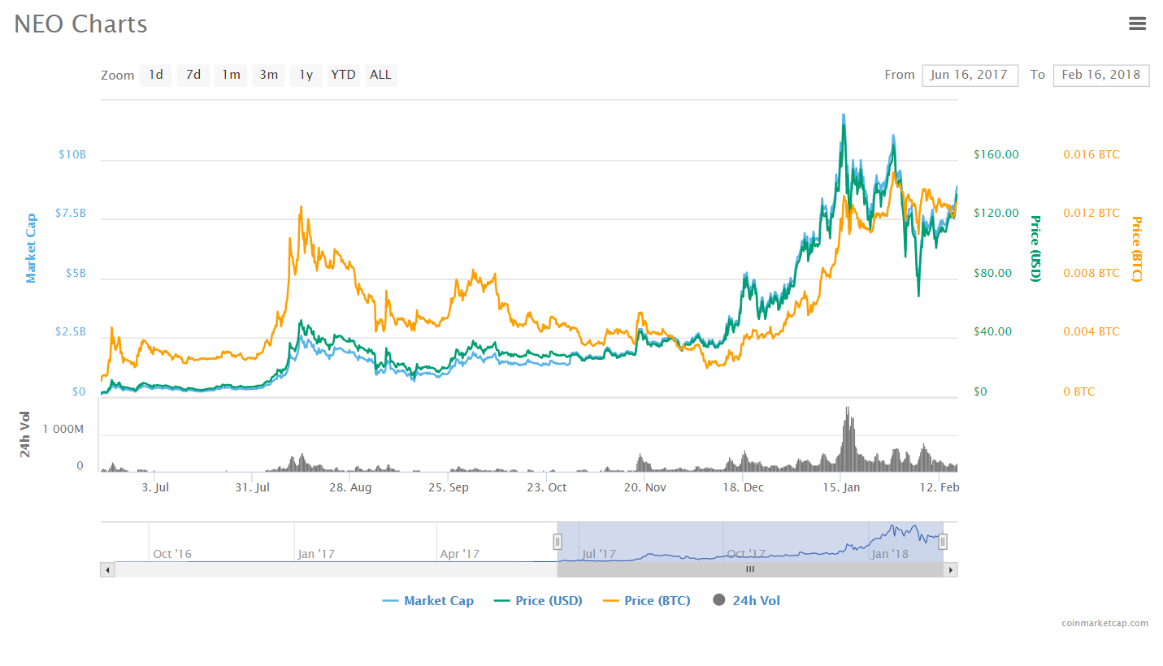
What is NEO?
PROJECT: NEO (https://neo.org/) is a non-profit, community-based blockchain project that utilizes blockchain technology and digital identity to digitize assets, to automate the management of digital assets using smart contracts, and to realize a "smart economy" with a distributed network.
DUAL CRYPTOCURRENCY: $NEO and $GAS
SOFTWARE PLATFORM: 3rd generation distributed applications (dApp) platform
Multiple languages: C# (reference implementation), Python, Java, Golang, JavaScript
First dApp platform suitable for enterprise application development, deployment, and operations
NEO SMART ECONOMY
Key differentiator
GLOBAL COMMUNITY
Discord: https://discord.gg/gqCYeup / https://discord.gg/4TQujHj
NEO C# Developers Center of Excellence (neo-csharpcoe) https://github.com/mwherman2000/neo-csharpcoe/blob/master/README.md
NEL (NewEcoLab) “Chinese-speaking NEO Community” https://github.com/neweconolab
City of Zion “Home of the Open-source Global NEO Developer Community” https://cityofzion.io/

Slide 12
Dual Cryptocurrency Model: NEO and NeoGas
NEO Smart Economy, there is a separation of concerns:
NEO represents Voting Power
NeoGas represents Ability to Fund Work (Systems Fees)
NEO (NEO)
Intended use: acquire, hold, and retain NEO to maximize your voting power in the network
Receive distributions of GAS
NeoGas (GAS)
Sometimes referred to as a “Utility Token” or the “Fuel Token”
Used to fund the deployment of smart contracts (applications) on the NEO Blockchain
Used to fund transactions executed on the NEO Blockchain
System Fees are recycled and re-distributed in ratio/proportion to the number of NEO you hold

Slide 13
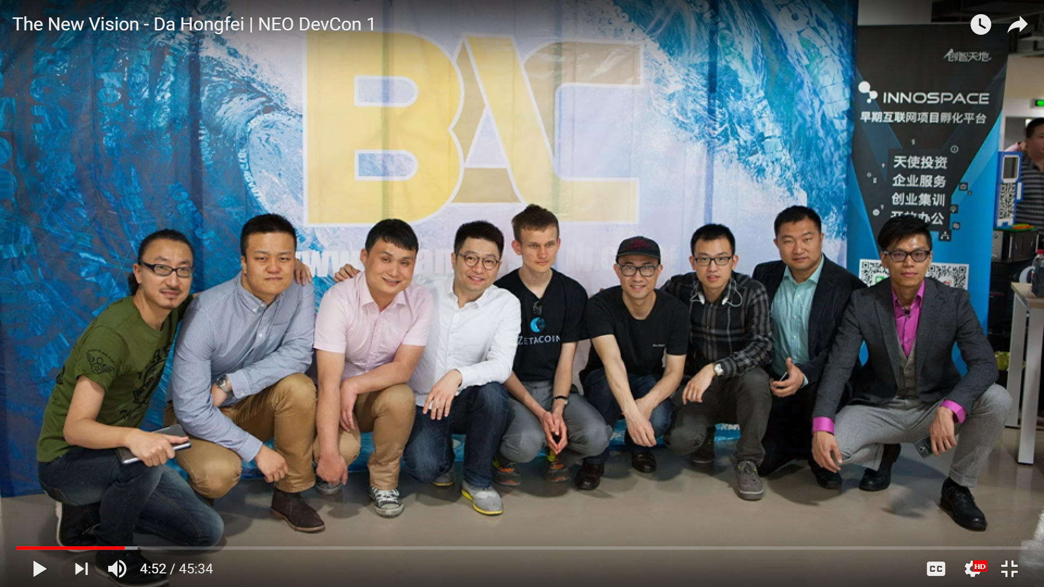
2013 - BitAngelsCloud

Slide 14
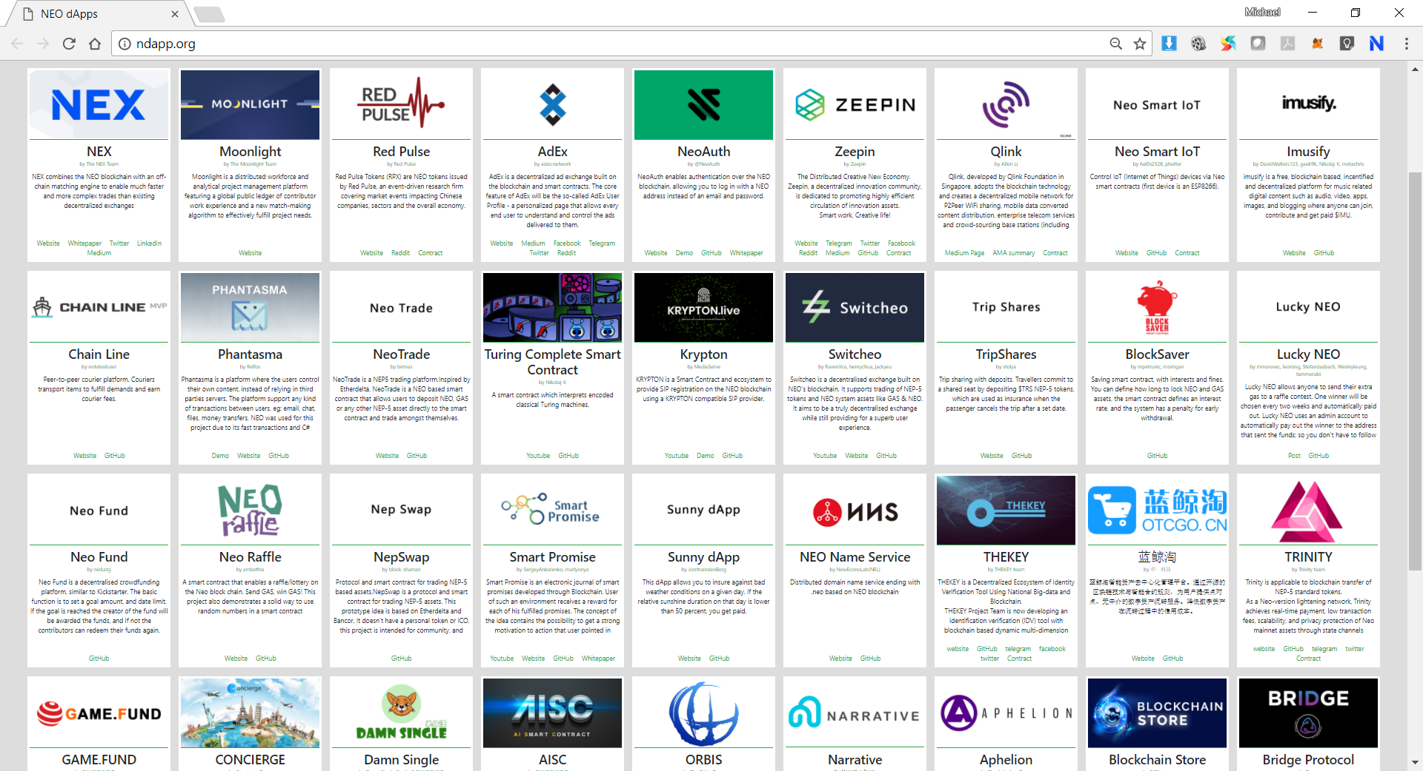

Slide 15
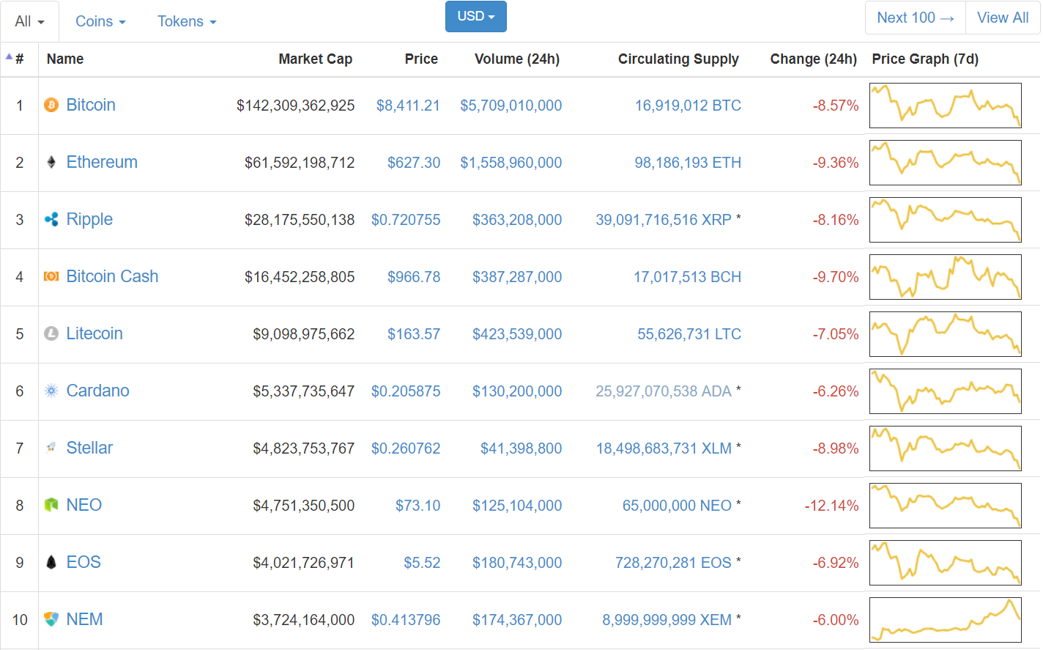
March 14, 2018 2:05PM

Slide 16
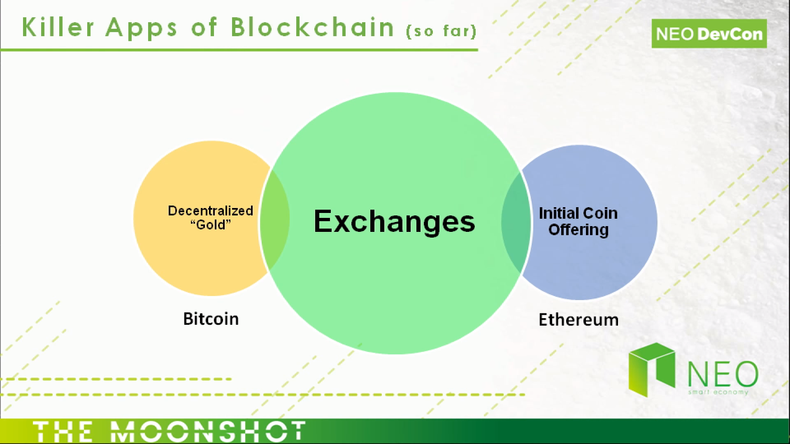
What’s the next category of Blockchain Killer Apps?

Slide 17
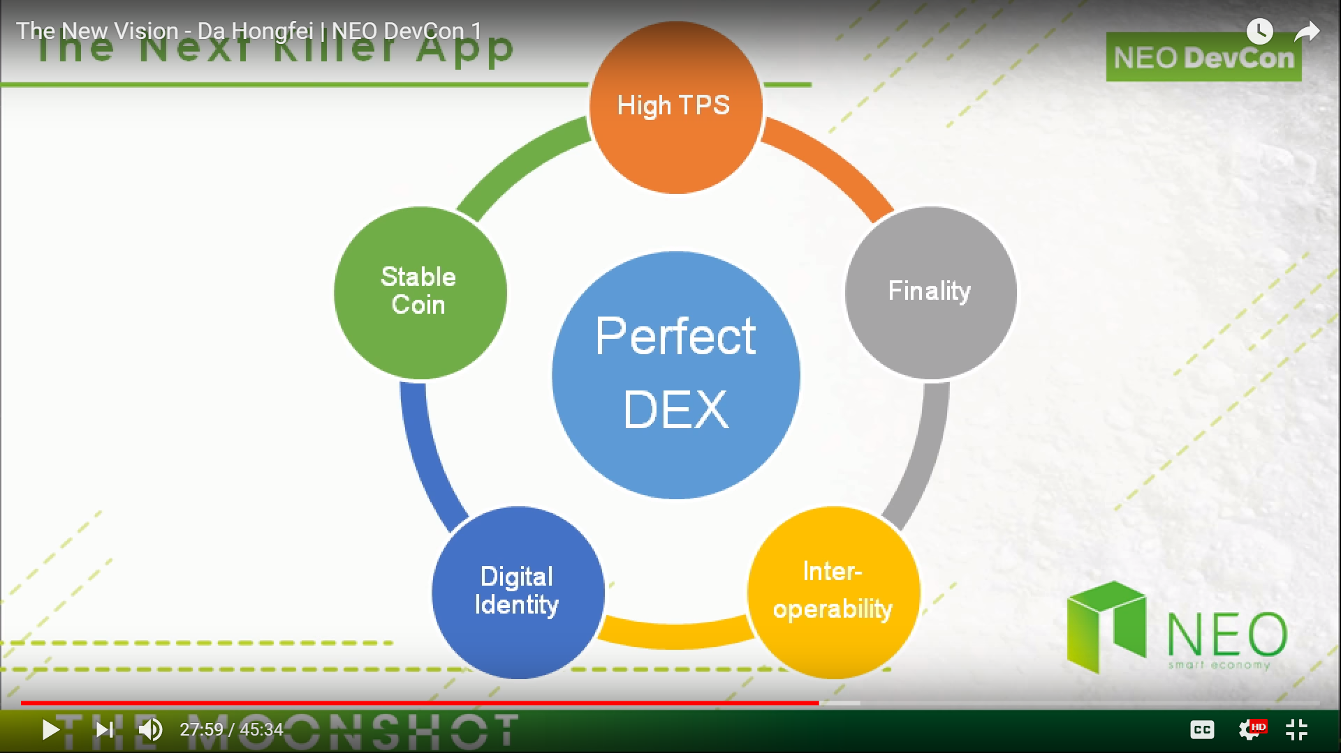

Slide 18
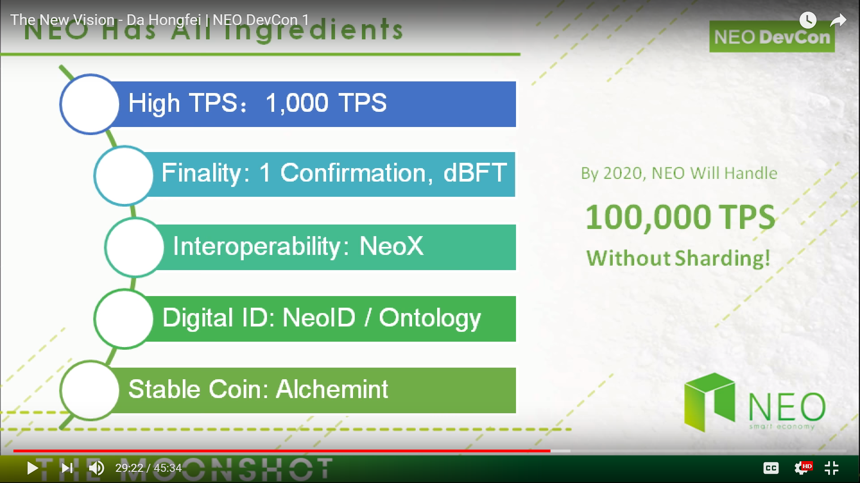
Next Killer Blockchain Platform?

Slide 19
2. NEO Whitepaper
“NEO is the use of blockchain technology and digital identity to digitize assets, the use of smart contracts for digital assets to be self-managed, to achieve [a] “smart economy” with a distributed network.”

Slide 20



What is the NEO Smart Economy?
Digital Assets
+
NEO
Smart Economy
Digital Identity
+
Smart Contracts
Future world where the boundary between real assets in the physical world and digital assets in the digital world has been removed.

Slide 21
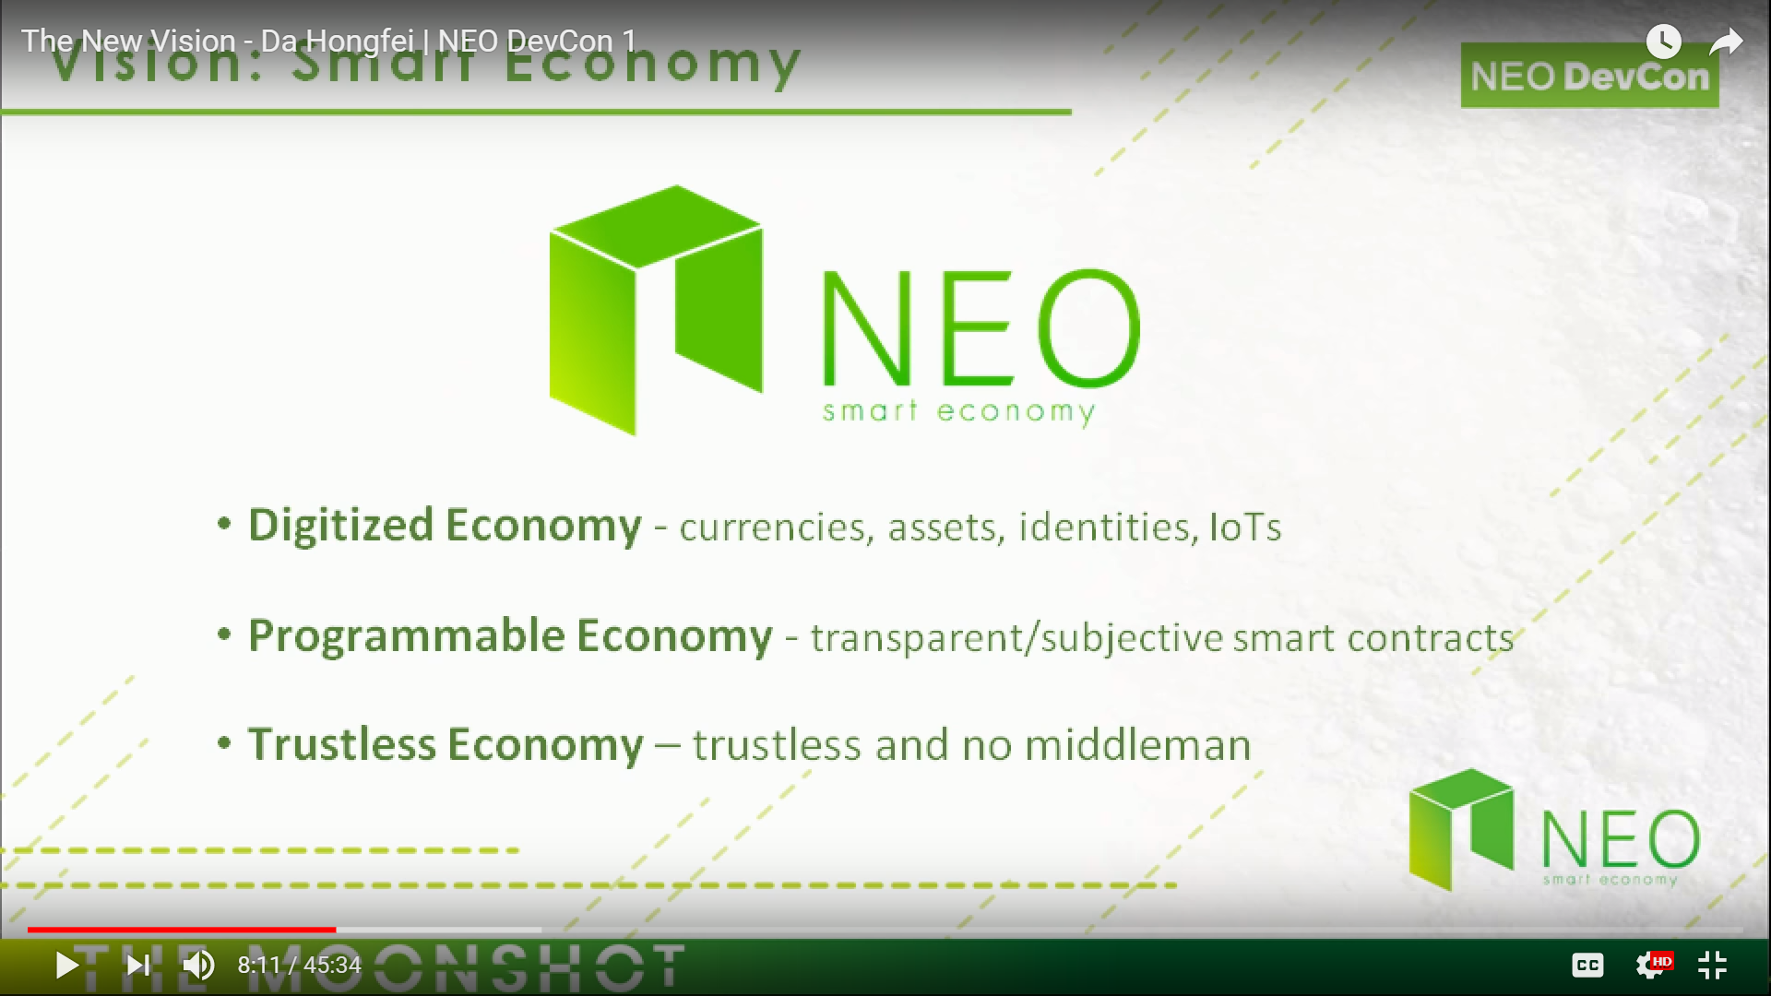

Slide 22
NEO Decentralized Applications (Use Cases)
Smart fund
AI-assisted legal smart contracts
Social networking
Automated tokens liquidity providers
Decentralized exchange
Secure communications protocol
Data exchange market
Intellectual property trading market
Prediction market
Advertising market
Hashpower market
NeoGas market

Slide 23
NEO Management Model: Economic Model
Dual Cryptocurrency Model: NEO and NeoGas
NEO
NEO Whitepaper: “right to manage the network”
“Bookkeeping, network parameter change, and so on”
100 million total tokens
Not divisible: minimum unit = 1 NEO
NeoGas (GAS)
NEO Whitepaper: “fuel token”
“Network charges for the operation and storage of tokens and smart contracts”
“Creating economic incentives for bookkeepers and preventing abuse of resources”
Maximum of 100 million tokens
Divisible: minimum unit = 0.000,000,01 GAS

Slide 24
NEO Management Model: Economic Model
Genesis Block 0
“100 million NEOs was generated”
“Zero GAS was generated”
“100 million GAS, corresponding to the 100 million NEO, will be generated through a decay algorithm in about 22 years time to addresses holding NEO”
“If NEO is transferred to a new address, the subsequent GAS generated will be credited to the new address”

Slide 25
NEO Management Model: Distribution Mechanism
NEO
First 50 million NEO
“50 million NEO has been distributed proportionately to supporters of NEO during the crowdfunding”
Second 50 million NEO
“10 million tokens (10% of total) – motivate NEO developers and NEO Council members”
“10 million tokens (10% of total) – motivate developers in the NEO ecosystem”
“15 million tokens (15% of total) – cross-investment in other blockchain projects (owned by the NEO Council and only used for NEO projects)”
“15 million tokens (15% of total) – retained as contingency”
“Annual use of NEO in principle should not exceed 15 million tokens”

Slide 26
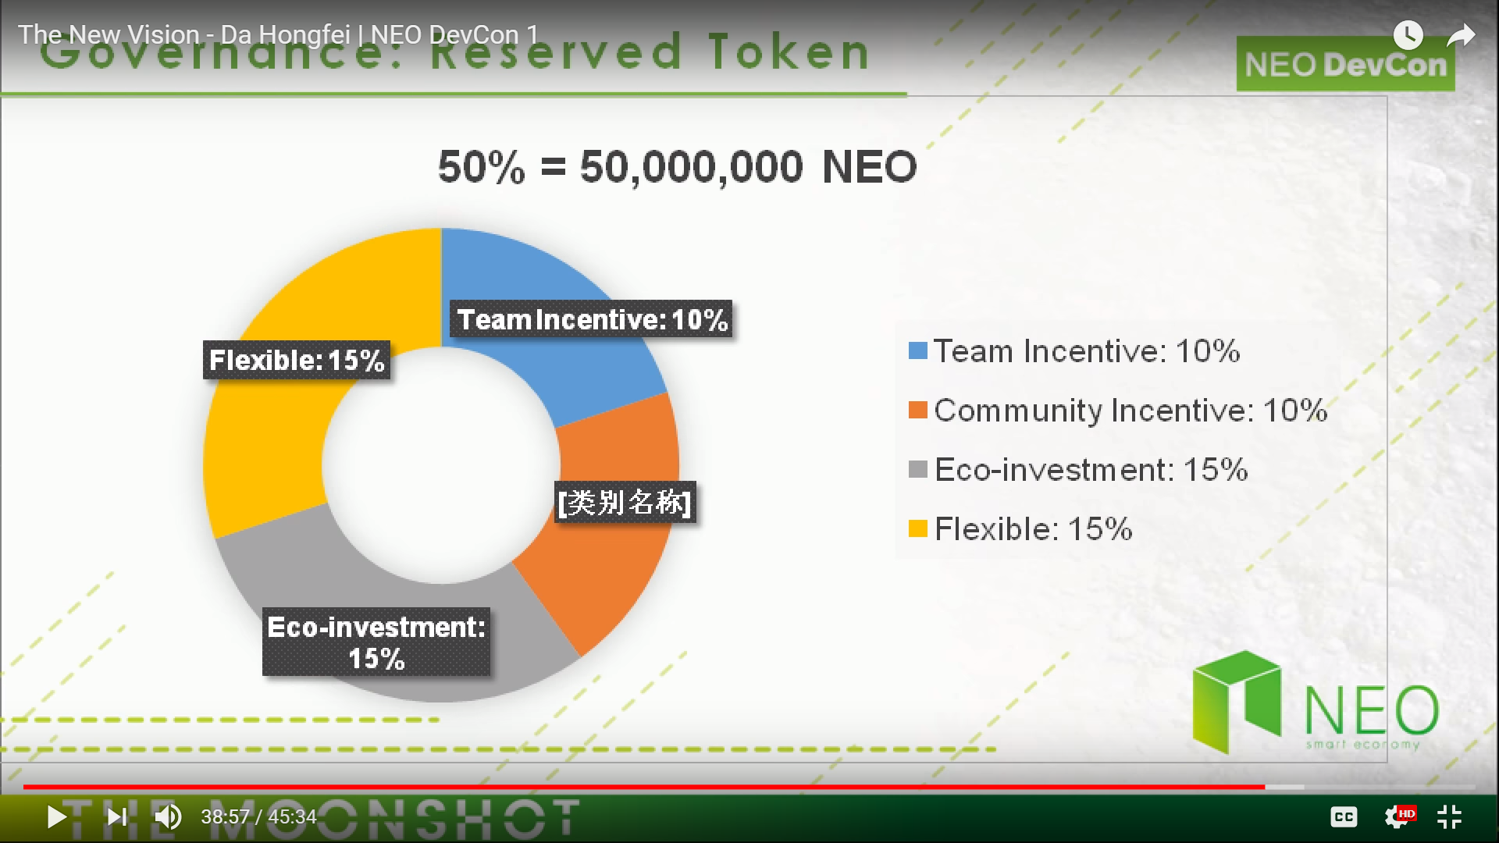

Slide 27
NEO Management Model: Distribution Mechanism
GAS
“GAS is generated for each new block. The initial amount of GAS is zero.”
“With the increasing rate of new block generation, the total limit of 100 million GAS will be achieved in about 22 years.”
“Interval between blocks is 15-20 seconds. 2 million blocks are generated in about one year.”
“Initial GAS generation will be 8 GAS per block.”
“Annual reduction of 1 GAS per block, per year, to coincide with the passing of every 2 millions blocks.”
“Reduction will continue down to just 1 GAS per block and will be held at that rate for around 22 years.”
“After the 44 millionth block, the total GAS generated will have reached 100 million and from this point on there will be no further [GAS] generation from new blocks.”
“Release curve: 16% of total GAS will be created in the first year, 52% of the GAS will be created in the first four years, and 80% will be created in the first 12 years.”
“Gas will be distributed proportionally in accordance with the NEO holding ratio, recorded in the corresponding addresses.”

Slide 28
NEO Management Model: Governance Mechanism
Chain Governance
“NEO Token Holders are the network owners and managers, managing the network through voting in the network.”
“Using GAS generated from NEO to utilize the functions of the network.”
Off-Chain Governance
“NEO Council consists of the founding members of the NEO project.”
“Under which the management committee, technical committee and the secretariat, respectively, are responsible for the strategic decision-making, technical decision-making, and specific implementation.”
“NEO Council is responsible to the NEO Community for the promotion and development of the NEO ecosystem as its primary objective.”

Slide 29
NEO Technology/Implementation: Consensus Mechanism Delegated Byzantine Fault Tolerance (dBFT)
Delegated Byzantine Fault Tolerance (dBFT) consensus mechanism is used by NEO
“Byzantine fault-tolerant consensus mechanism that enables large-scale participation in consensus through proxy voting.”
“The holder of the NEO token can, by voting, pick the bookkeeper it supports.”
“The selected group of bookkeepers, through BFT algorithm, reach a consensus and generate new blocks.”
“Voting in the NEO network continues in real time, rather than in accordance with a fixed term.”

Slide 30
NEO Technology/Implementation: Consensus Mechanism Delegated Byzantine Fault Tolerance (dBFT)
“The dBFT provides fault tolerance of f = ⌊ (n-1) / 3 ⌋ for a consensus system consisting of n consensus nodes.”
“This fault tolerance also includes both security and availability, resistant to general and Byzantine failures, and is suitable for any network environment.”
“dBFT has good finality, meaning that once confirmations are final, the block can not be bifurcated, and the transaction will not be revoked or rolled back.”

Slide 31
NEO Technology/Implementation: Consensus Mechanism Delegated Byzantine Fault Tolerance (dBFT)
“In the NEO dBFT consensus mechanism, taking about 15 to 20 seconds to generate a block, the transaction throughput is measured up to about 1,000TPS, which is excellent performance among the public chains.”
“Through appropriate optimization, there is potential to reach 10,000TPS, allowing it to support large-scale commercial applications.”
“The dBFT combines digital identity technology, meaning the bookkeepers can be a real name of the individual or institution.”
“Thus, it is possible to freeze, revoke, inherit, retrieve, and ownership transfer due to judicial decisions on them.”
“This facilitates the registration of compliant financial assets in the NEO network. The NEO network plans to support such operations when necessary.”

Slide 32
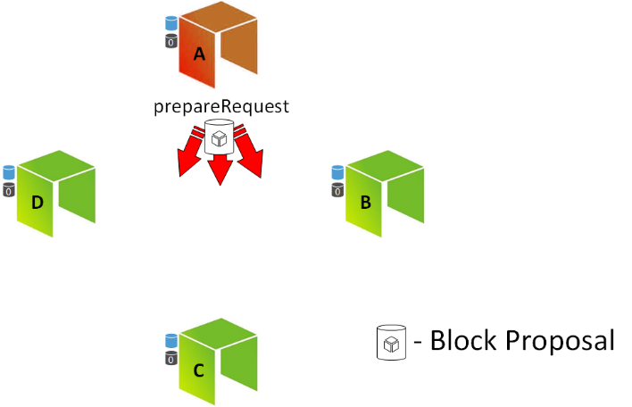
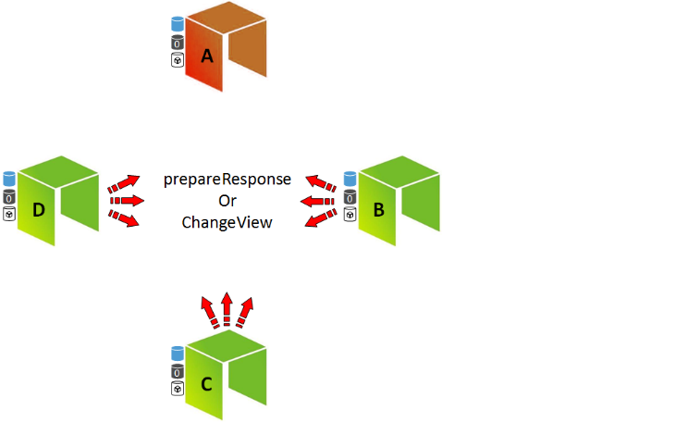
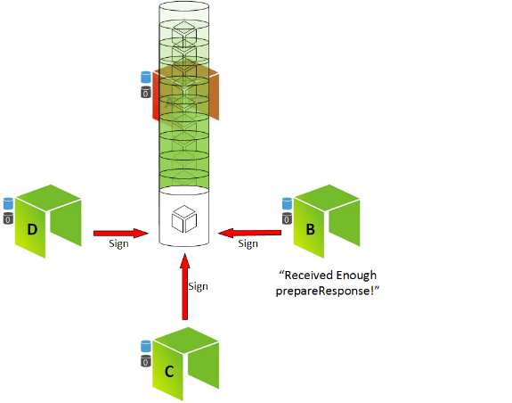
Delegated Byzantine Fault Tolerance (dBFT) NEO Consensus Mechanism
NEO: There is no competition to create the next block (e.g. no miners, no PoW)
NEO: There is no betting or staking to choose the next block (e.g. no PoS)
NEO: Consensus nodes are voted in as representatives to choose the next block
NEO: No reward for your own node to be selected

Slide 33




Problems with Proof of Work and Proof of Stake
1. Proof of Work (PoW)
2. Proof of Stake (PoS)

Slide 34
PoW and PoS compared to dBFT
Consensus algorithm: PoW and PoS
Consensus algorithm: dBFT
One and only one branch

Slide 35
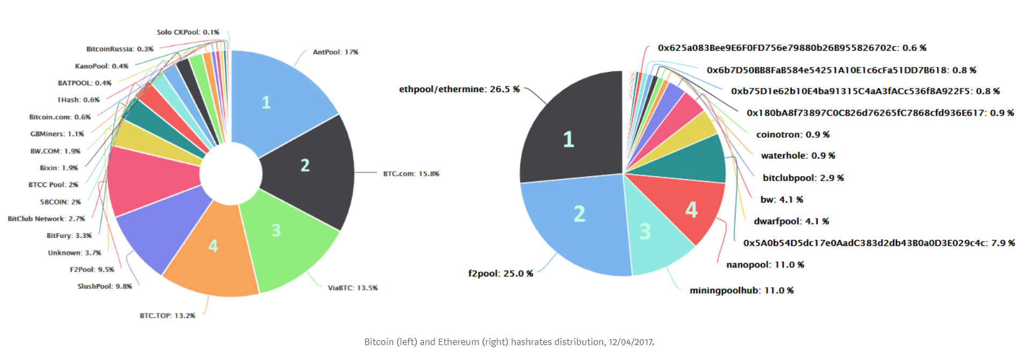
How decentralized are the BTC and ETH networks?
Coopetition: A New Approach to Decentralization https://medium.com/proof-of-working/decentralization-from-coopetition-b10d7ce3b9d

Slide 36
“I want to be become a NEO Consensus Node”
Very little economic reward/incentive
Transactions fees need to be kept at zero or close to zero
Else you will run the risk of your node getting voted out
High initial cost
1000 GAS (USD$30,000 – March 2018)
Need to a high balance in your NEO address
Else you further run the risk of your node being voted out
Primary motivation: Maintaining the integrity of the NEO network

Slide 37
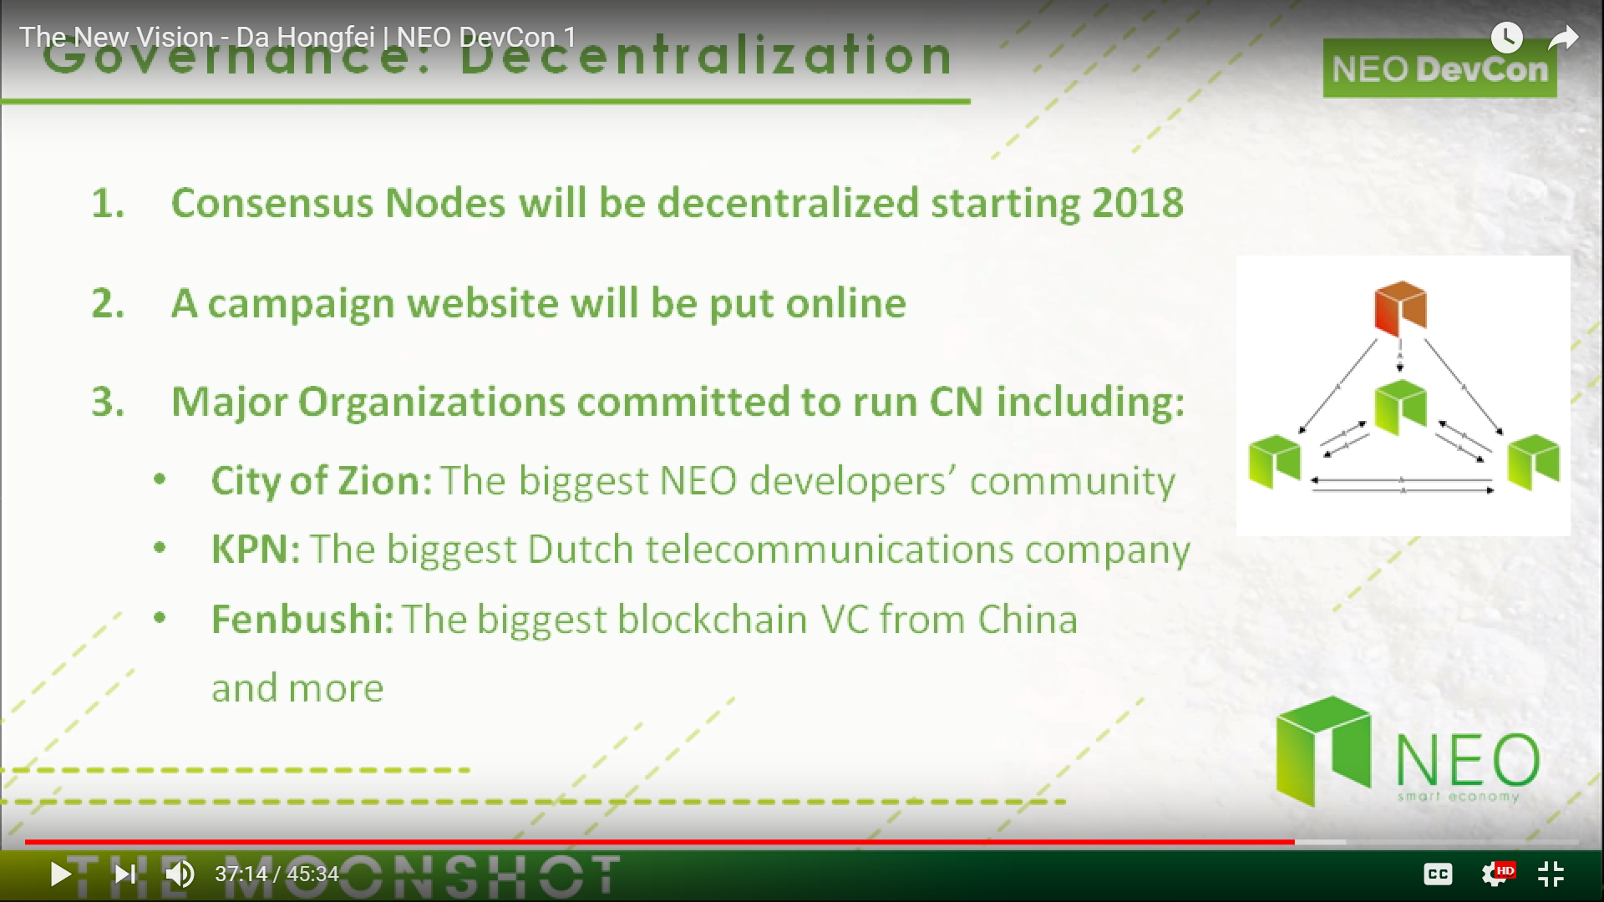

Slide 38
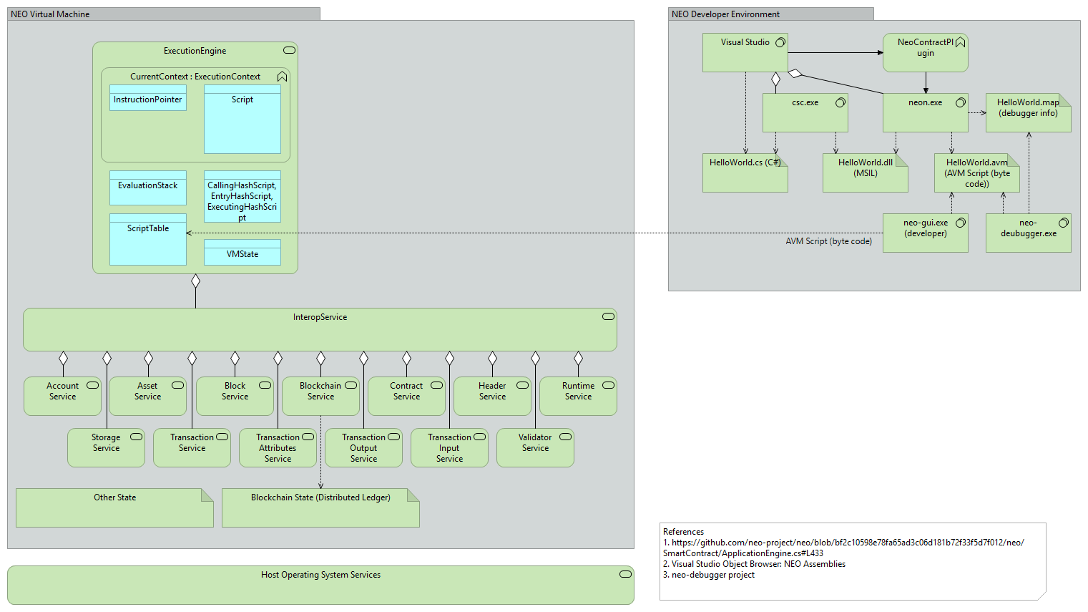
NEO Technology/Implementation: NeoContract

Slide 39
NEO System Fees
 | NEO [Gas] |  |  | NEO [Gas]
Runtime.CheckWitness | 0.2 |  | OpCode.PUSH16 [or less] | 0.00
Blockchain.GetHeader | 0.1 |  | OpCode.NOP | 0.00
Blockchain.GetBlock | 0.2 |  | OpCode.APPCALL | 0.01
Blockchain.GetTransaction | 0.1 |  | OpCode.TAILCALL | 0.01
Blockchain.GetAccount | 0.1 |  | OpCode.SHA1 | 0.01
Blockchain.GetValidators | 0.2 |  | OpCode.SHA256 | 0.01
Blockchain.GetAsset | 0.1 |  | OpCode.HASH160 | 0.02
Blockchain.GetContract | 0.1 |  | OpCode.HASH256 | 0.02
Transaction.GetReferences | 0.2 |  | OpCode.CHECKSIG | 0.10
Account.SetVotes | 1 |  | OpCode.CHECKMULTISIG [per signature] | 0.10
Validator.Register | 1000 |  | Other OpCodes | 0.001
Asset.Create （system asset） | 5000
Asset.Renew （system asset） | 5000
Contract.Create | 500
Contract.Migrate | 500
Storage.Get | 0.1
Storage.Put [per KB] | 1.0
Storage.Delete | 0.1
Other OpCodes | 0.001

Slide 40
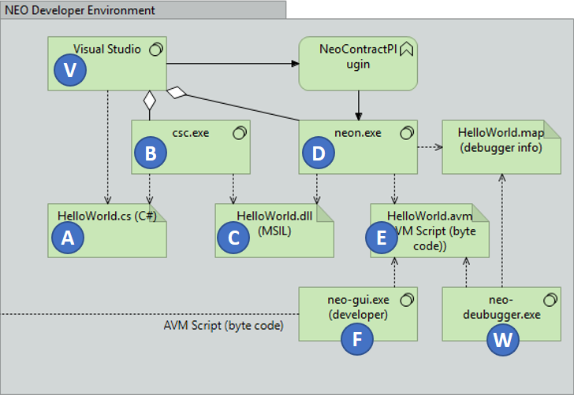
NEO Technology/Implementation: NeoContract

Slide 41
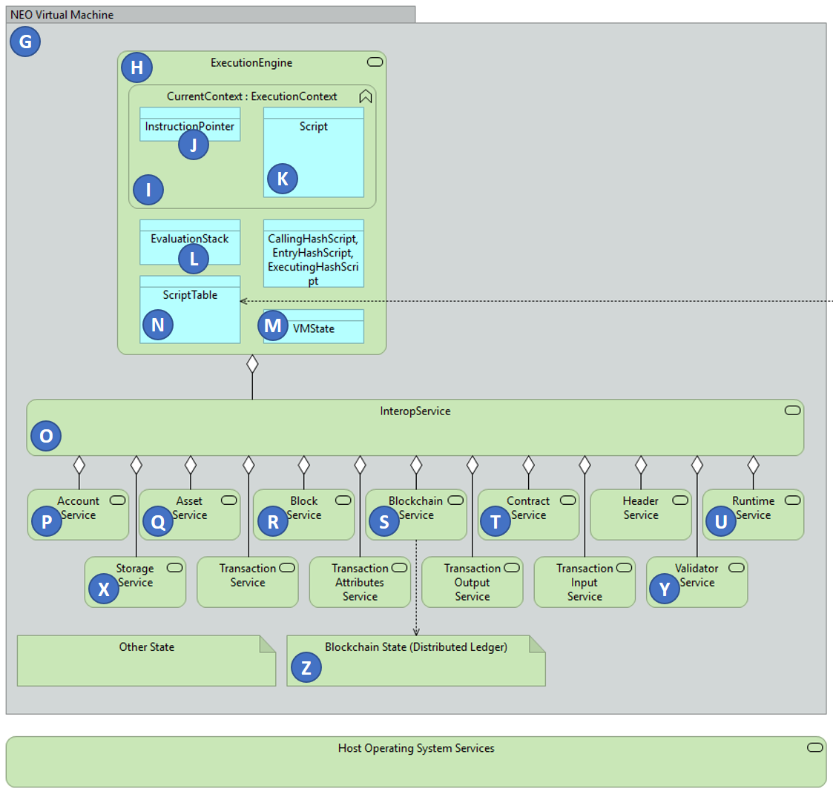
NEO Technology/Implementation: NeoContract

Slide 42

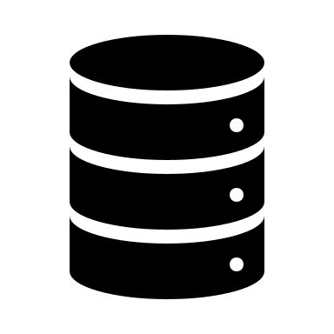


NEO Technology/Implementation: NeoX Protocol Cross-chain Interoperability
ONT
DNA
ONT
ONT
DNA
DNA

Slide 43
3. Aside: Why do things have value?
Why do they appreciate?

Slide 44
Aside: Why do things have value? Why do they appreciate? Michael’s Theorem
It’s all about Scarcity
Real or perceived
Simpler terms: Supply and Demand (but I prefer the term scarcity)
The difficulty or cost of acquiring new or additional assets
Money, diamonds, gold, ..., cryptocurrencies
The difficulty or cost of product or manufacturing new assets
Bitcoin, Ethereum (ETH)
Proof of Stake (PoS) concensus/verification processes
Millions of miners competing: HUGELY wasteful, expensive, slow
Could be through the regulation of price and/or supply – illusion of scarcity
“Mining is a process of validating a transaction or block in a network by the process of complex algorithms to prove and validate the correctness of the transaction and thereby add the new block to the chain.” [https://medium.com/@karthik.seshu/cryptocurrency-proof-of-work-vs-proof-of-stake-e1eee1420b10 ]

Slide 45
What happens when things become easier to acquire? Michael’s Theorem
What happens when things become easier to make/manufacture?
What happens to the price of ETH when Ethereum moves to Proof of Work (PoW)?
Millions of competing miners aren’t needed for Ethereum anymore
Maybe they move back into Bitcoin mining – perhaps driving down the cost of a Bitcoin?
NEO Blockchain uses Delegated Byzantine Fault Tolerance (dBFT)
Currently runs 8 nodes WW to support about 1000TPS throughput
By 2020, NEO estimates this will need to grove to 12 nodes to achieve 100,000TPS
Very small number of nodes

Slide 46
4. Why NEO?

Slide 47
The Problems with PoW* and PoS*
This structure is however in direct conflict with the interest of decentralized applications.
Many large scale applications need the transactions to be free of charge for the end user, while still ensuring stable service (transaction time). This will always be a conflict of interest for PoW and PoS systems.
Block creators are incentivized by economic rewards
If a transaction does not include a transaction fee, then the block creators have no interest in resolving it.
This is just how PoW and PoS has to be structured. If there is no economic reward in creating blocks, then there will be less nodes participating in the network, directly influencing network security.
*PoW - Proof of Work
*PoS - Proof of Stake

Slide 48
Transaction Fees are Discouraged in the NEO Smart Economy
1
Each NEO token equals one vote for consensus nodes.
2
Consensus nodes may choose to refuse throughput upgrades because they have economic interest in transaction fees.
3
NEO holders only get system fees distributed to them, not transaction fees. More network usage equals more system fees, so NEO holders will work for increasing network throughput.
4
Because of point 3, consensus nodes that refuse throughput upgrades will not be re-voted as consensus nodes and other consensus nodes will be voted in.
5
Points 1-4 ensure that transaction fees are zero or near zero. Enterprises that want a decentralized application can safely develop on the NEO Blockchain without being worrying that their users may have difficulties in attaining the tokens they need.

Slide 49
NEO was created for Large Scale dApps*
Mainchain speeds
NEO 1000 – 10,000 TPS (single core)
BTC 3 – 4 TPS
ETH 10 – 20 TPS
No transaction fees Initial 10 GAS fee is for free. Simple Smart Contracts can be run for free.
More freedom for application developers to choose the business model that most suits to their business. Service and usage fees can be charged in any way off-chain.
Confirmations needed
NEO 1 and only 1
BTC 6+
ETH 20+
*dApps – Distributed Apps
NEO Persistable Classes make Enterprise App Development real

Slide 50
What is NEO? Summary
For large scale decentralized applications, transaction cost, transaction time (including confirmations) is a big obstacle and restriction to possible business models.
NEO is built for large scale dApps and is free to use for the end user. Fees (GAS) are instead charged for deploying contracts and registering assets.
Transaction volume is not an issue with 1000TPS+ on main chain and plenty off-chain scaling possibilites.
NeoX will make the NEO ecosystem quite unique. NEO contain the public ledger for digital assets, identity and smart contracts.

Slide 51
5. 3rd Generation Distributed App (dApp) Platform

Slide 52
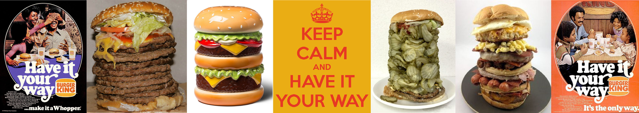
Smart Contracts: “Have it your Way”
Develop, debug and test Smart Contracts in the language you prefer
C# (reference implementation)
Python, Java, Golang, JavaScript
Develop, debug and test Client Apps using the frameworks you prefer
ASP.NET, WinForms, WPF, Console Applications, Window Services, …
Node.JS
Python, Java, Golang, JavaScript

Slide 53
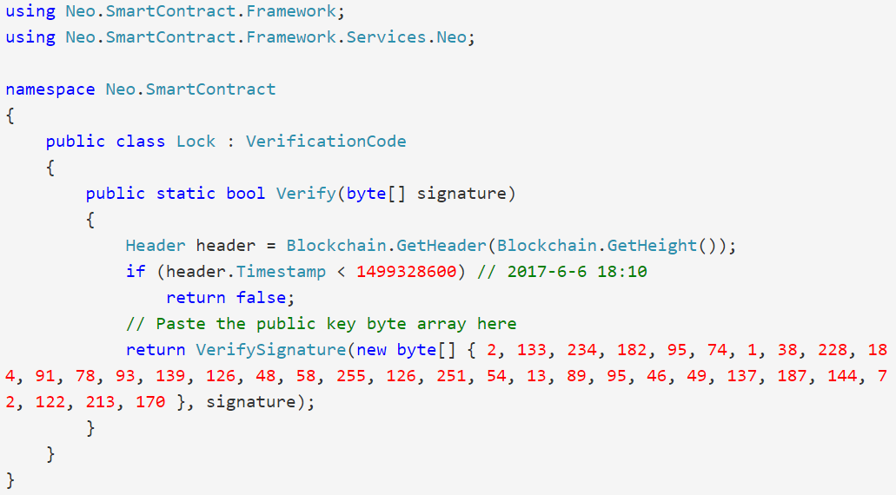
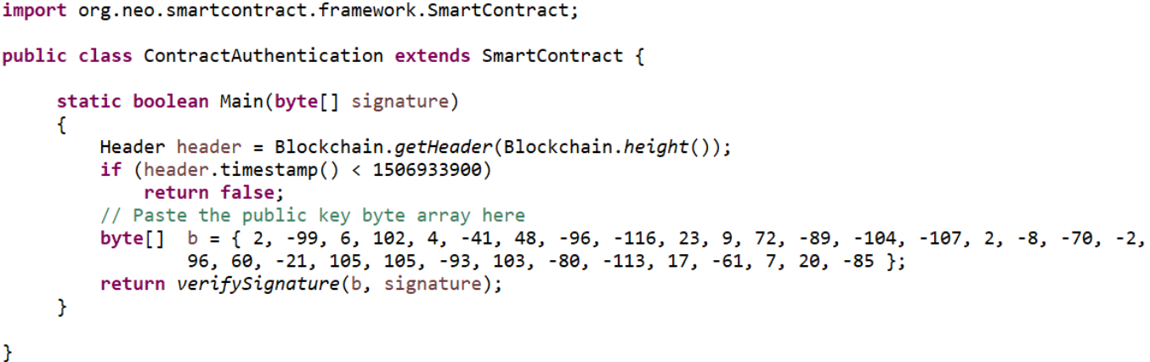
Smart Contracts: “Have it your way”

Slide 54
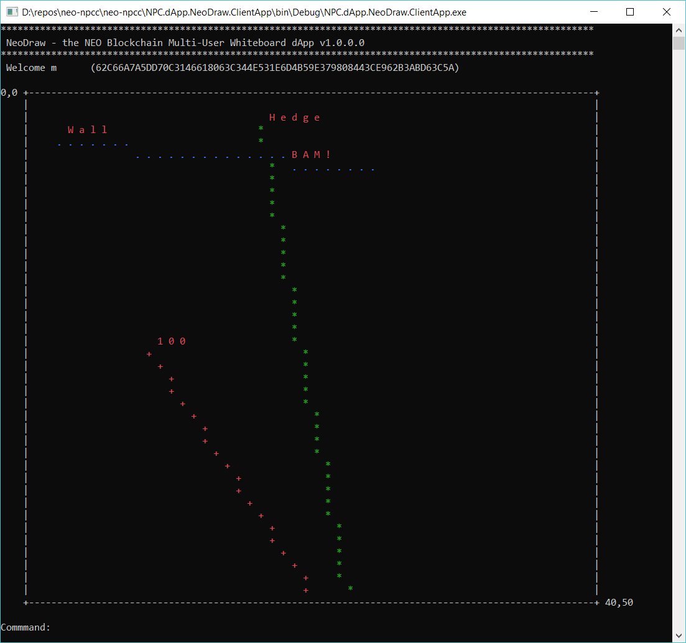
NeoDraw - NEO Multi-Person Shared Whiteboard dApp NEO Blockchain as an Enterprise Application Platform
NeoDraw is advanced proof-of-concept distributed application (dApp) for the NEO Persistable Classes (NPC) Entity-based dApp (e-dApp) Platform running on the NEO Blockchain.
Uses 3 entities
UserCredentials
User name and User Password
UserPoint
Array of (X,Y) coordinates/user
NeoCounter
Tracks number points/user

Slide 55
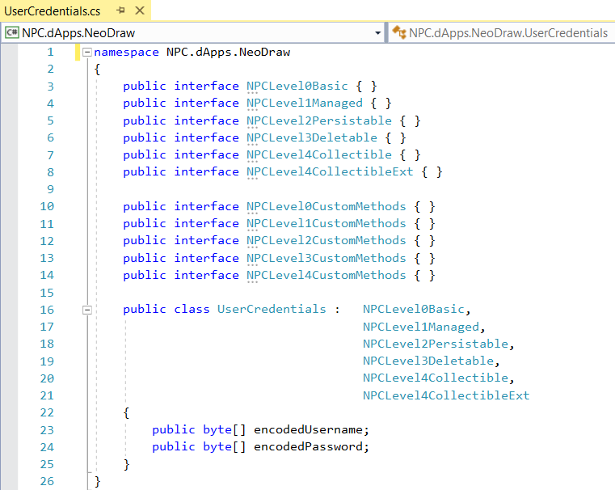
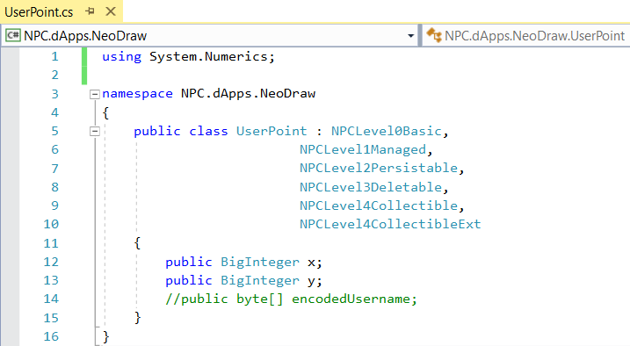
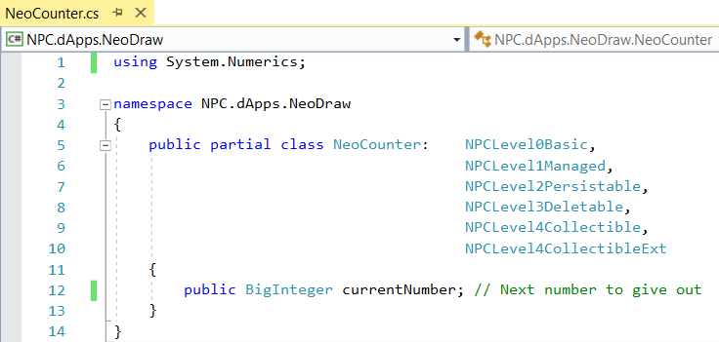
NeoDraw - NEO Multi-Person Shared Whiteboard dApp NEO Blockchain as an Enterprise Application Platform

Slide 56
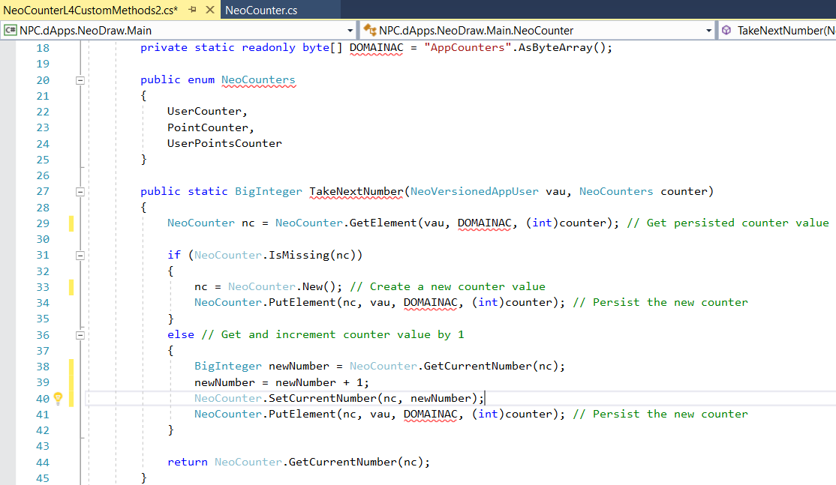
NeoDraw - NEO Multi-Person Shared Whiteboard dApp NEO Blockchain as an Enterprise Application Platform

Slide 57
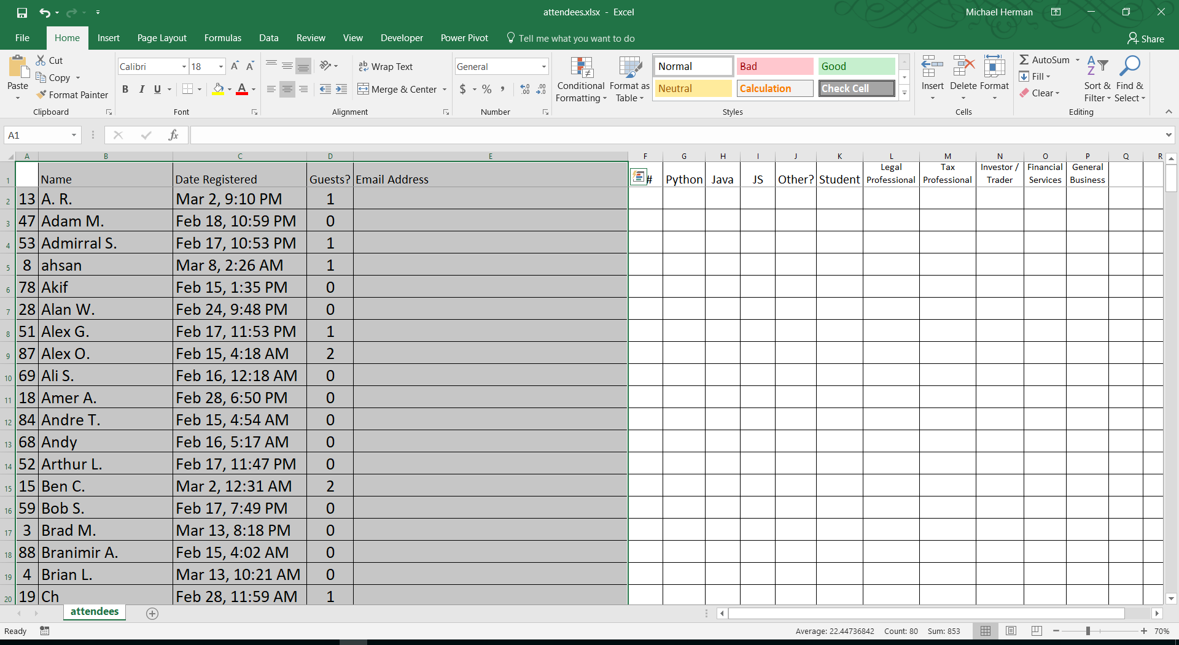
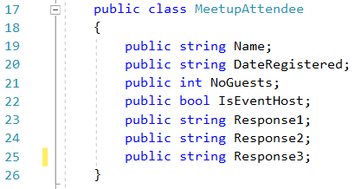
For our next meeting: Create a Meetup sign-in e-dApp

Slide 58
NEO C# Developer Tool Suite (March 2018)
NEO Blockchain Quick Start Guide for .NET Developers (mwherman2000/neo-dotnetquickstart)
NEO Persistable Classes (NPC) Compiler (mwherman/neo-npcc)
NEO NEON Compiler (neo-project/neo-compiler)
NEO Debugger (CityOfZion/neo-debugger-tools)
NEO Node/Wallet (Developer Edition) (CityOfZion/neo-gui-developer)
NEO PrivateNet Docker Container (metachris/neo-privnet-with-gas)
NEO TestNet Network (http://docs.neo.org/en-us/node/testnet.html)
NEO MainNet Network

Slide 59
Smart Contract Development: NEO or ETH?
Compare/contrast Ethereum and the NEO Blockchain
Ethereum
NEO
ETH Smart contract == single object/entity with a simple set of methods and simple types of data
The Ideal Application?
Blockchain version 2.0 Alt tokens
Simple, single entity with a few methods
Beyond that?
Very little future for Ethereum as an Enterprise Application platform
“One trick pony” x 1500
NEO Smart contract == a program capable of working with dozens of different types of objects/entities
Unlimited potential as an Enterprise Application Platform
Will drive acquisition of NEO
Automatic accumulation of GAS
Increased ability to participate in the NEO Smart Economy
Voting as well as having operating funds
The NEO Blockchain is better (superior) for Enterprise Distributed Applications

Slide 60
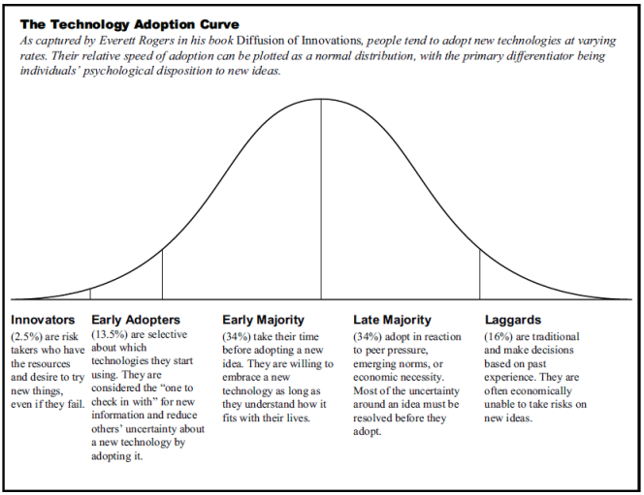
NEO Blockchain as a Enterprise Application Platform
Focus of any new platform…
Scalability
Reliability
Inexperience
Right tools
Knowledge
Education
Training
…

Slide 61
Entity-based Distributed Applications (e-dApps)
enabled by NEO Persistable Classes Platform

Slide 62
6. NEO Evidence

Slide 63
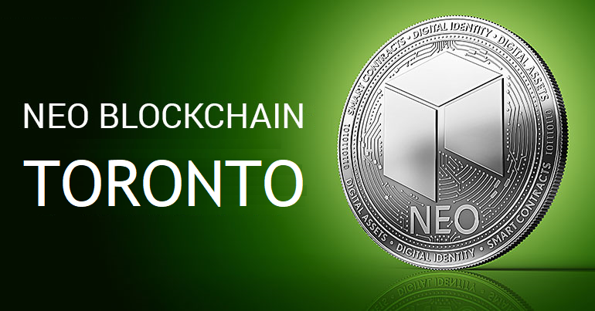
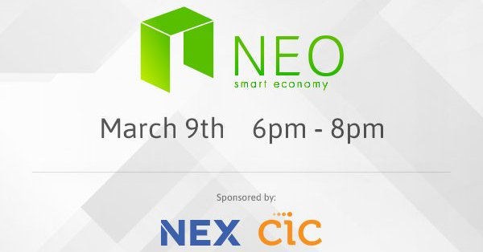

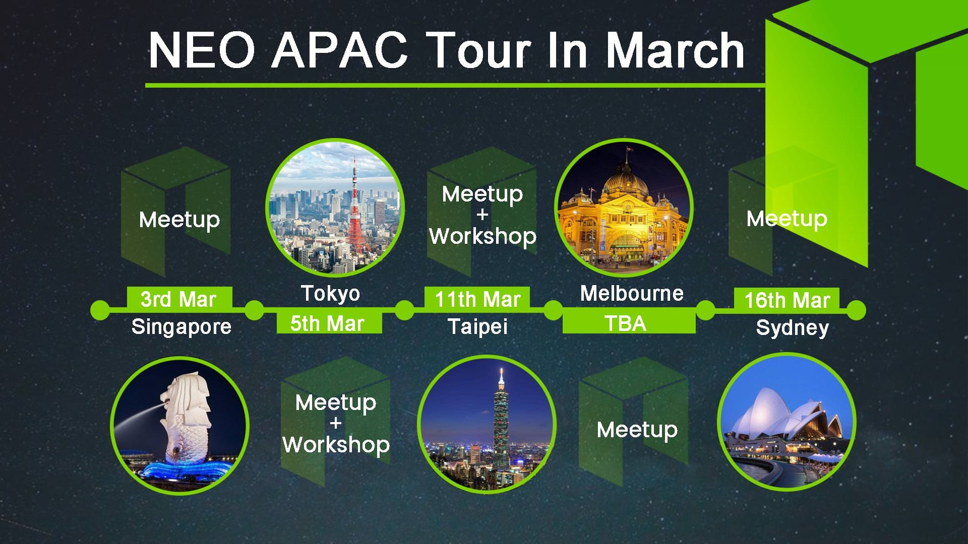
NEO Events
Second Wednesday evening of each month
Boston Smart Economy Meetup
HackCU Episode IV · University of Colorado Boulder
600 Hackers · 24 Hours · February 24th and 25th 2018
NEO APAC Tour – March 2018

Slide 64
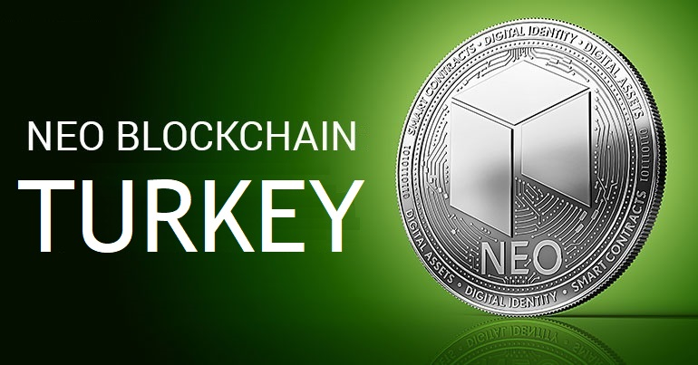

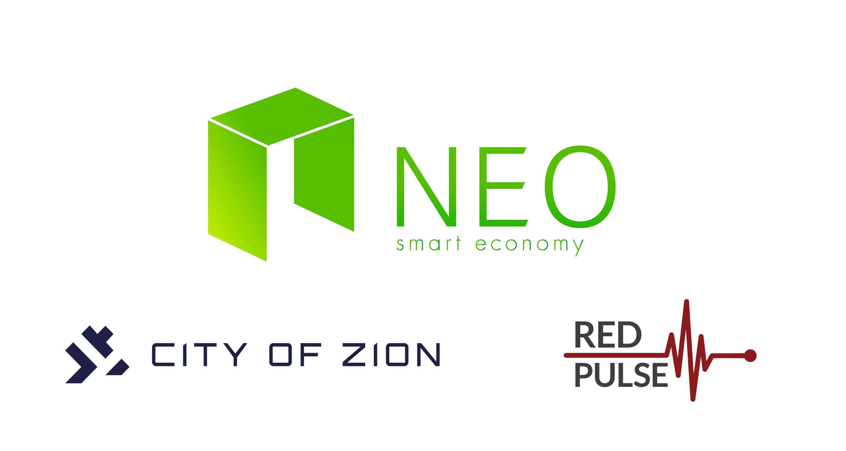
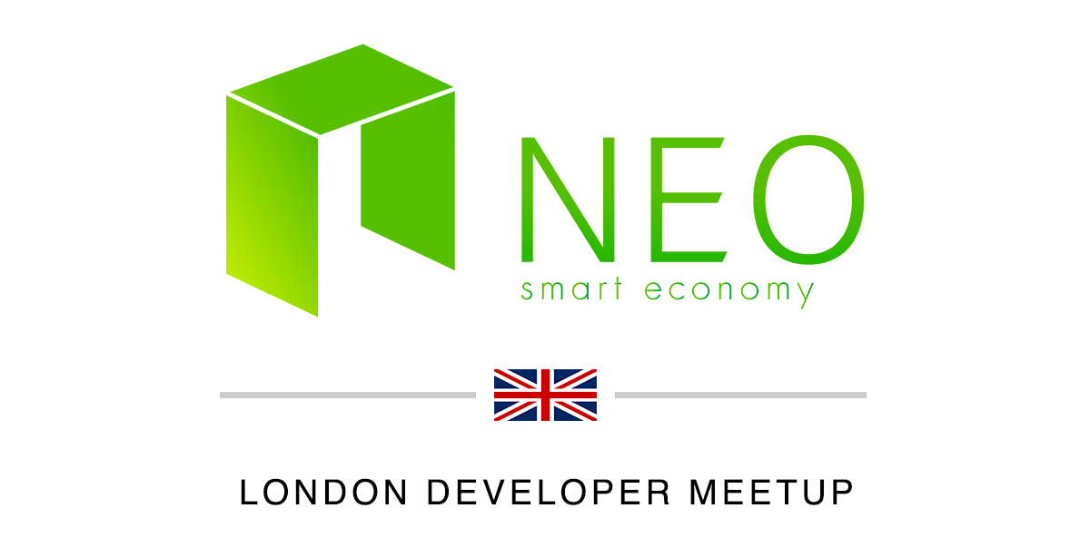
NEO Events (con’t)
NEO Blockchain Turkey
NEO Taipei Meetup
NEO Austria Meetup
London NEO Meetup

Slide 65
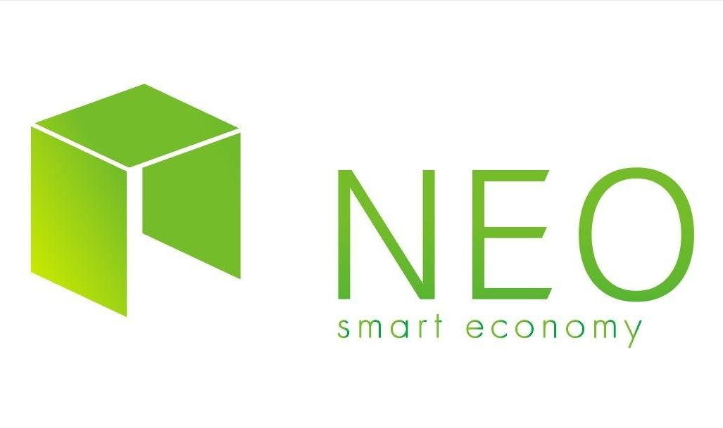
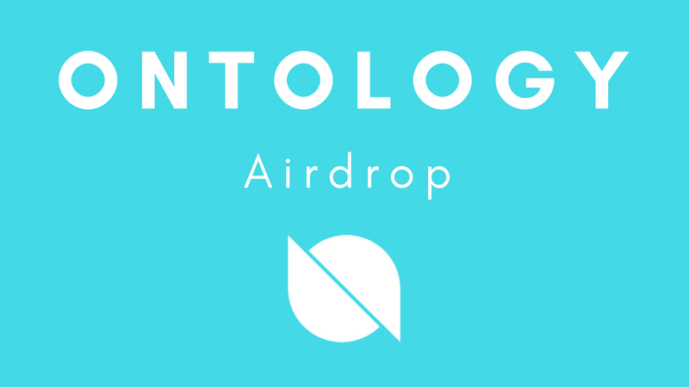
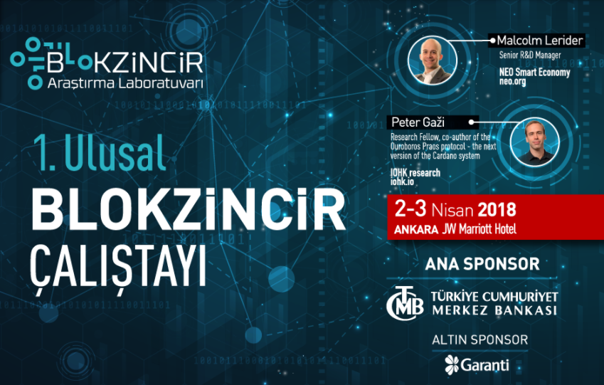
NEO Events (con’t)
Second Thursday evening of each month
NEO Tokyo Meetup
Ontology Community Airdrop
March 2018
NEO Eastern European Tour – March-April 2018 Turkey, Bulgaria, Ukraine

Slide 66
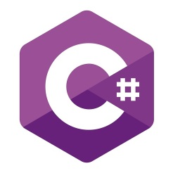

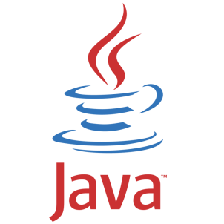

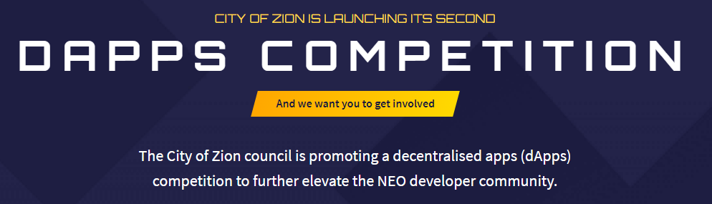

NEO dApp Competitions ~USD$500K in prizes

Slide 68
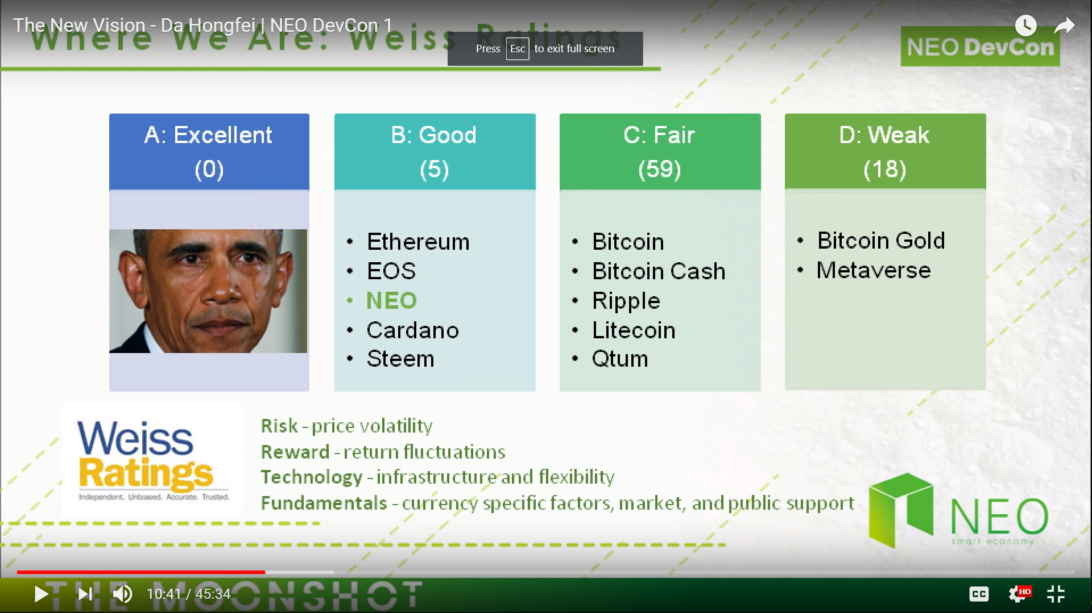

Slide 69
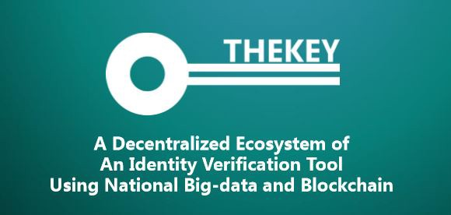
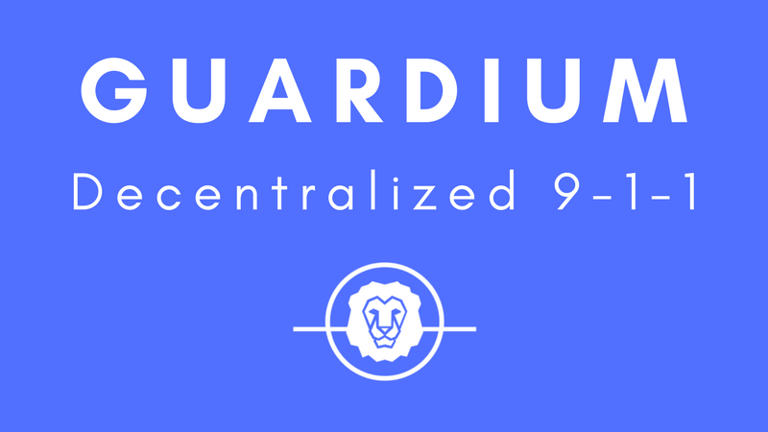


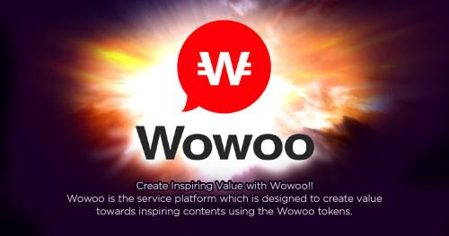
NEO News: Switchers
[QTUM to NEO] THEKEY, a Decentralized Ecosystem of Identity Verification Tool Using National Big-data and [NEO] Blockchain https://www.reddit.com/r/NEO/comments/7areac/ama_on_9th_nov_thekey_a_decentralized_ecosystem/
[ETH to NEO] Guardian Circle announce switch to NEO platform https://neonewstoday.com/general/guardium-announce-switch-to-neo-platform/ “...the more we dug into NEO, the more we realized that they had really great answers to every one of our concerns with Ethereum and many additional benefits that are unique to the NEO ecosystem.”
[ETH to NEO] Narrative project: Big News: KYC and Our Switch to NEO https://blog.narrative.network/big-news-kyc-and-our-switch-to-neo-2f34215beef9
[ETH to NEO] Concierge.io NEO Token Sale https://medium.com/@concierge.io/concierge-io-neo-token-sale-f870a0a27b04
[ETH to NEO] IMPORTANT NEWS FOR THE WOWOO COMMUNITY http://wowoonet.com/news.html#news_2018_6
[ETH to NEO] Three things to consider when choosing a blockchain for your project — or why Veris chose NEO. https://medium.com/verisfoundation/three-things-to-consider-when-choosing-a-blockchain-for-your-project-or-why-veris-chose-neo-b4483135c382
[Blockchain agnostic strategy] Jibrel Network founder looking to switch from Ethereum to NEO https://imgur.com/oHYTYi2

Slide 70
7. Resources

Slide 71
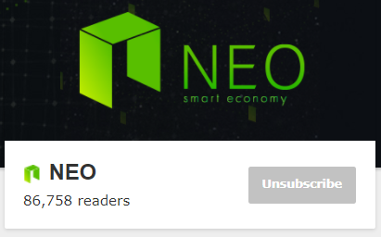
NEO Resources: Videos and Webcasts
The New Vision - Da Hongfei https://www.youtube.com/watch?v=th7jZlmoZBc
Malcolm Lerider: Clarification on NEO, GAS and Consensus Nodes https://www.youtube.com/watch?v=iV4WREWtCiI
A Deep Dive into NeoVM & NeoContract [English Subtitles] https://www.youtube.com/watch?v=fLppte-guYE
NEO Persistable Classes (NPC) e-dApp Smart Contract Platform 2.0: Deep Dive https://www.youtube.com/watch?v=Nj4-m2o94VE
NEO – Reddit https://www.reddit.com/r/NEO/

Slide 72
NEO Resources: NEO DevCon 1, January 2018
The New Vision - Da Hongfei | NEO DevCon 1 https://www.youtube.com/watch?v=th7jZlmoZBc
Opening Address - Scott Hunter, Microsoft | NEO DevCon 1 https://www.youtube.com/watch?v=ZFsu5HPU2xM
Ontology, The Technical Vision of Distributed Trust Networks | NEO DevCon 1 https://www.youtube.com/watch?v=QyaZz0vtONs
Imusify, Decentralized Platform for Music Related Digital Content | NEO DevCon 1 https://www.youtube.com/watch?v=dgmfO8nKJkE
NeoAuth, Login Using the NEO Blockchain | NEO DevCon 1 https://www.youtube.com/watch?v=F7teukbcbIg
Phantasma, User-Owned Content | NEO DevCon 1 https://www.youtube.com/watch?v=cinexz6gjsU
NEO•ONE, Development Framework | NEO DevCon 1 https://www.youtube.com/watch?v=yWzjNhiZFmA
THEKEY, A Decentralized Ecosystem of An Identity Verification Tool | NEO DevCon 1 https://www.youtube.com/watch?v=St-UW0lPB7o
NEO’s Global Vision and the Evolving Regulatory Environment - Miles Graham | NEO DevCon 1 https://www.youtube.com/watch?v=FidRGNeab3I
NEX, Decentralized Exchanges | NEO DevCon 1 https://www.youtube.com/watch?v=1005ed20e0Q

Slide 73
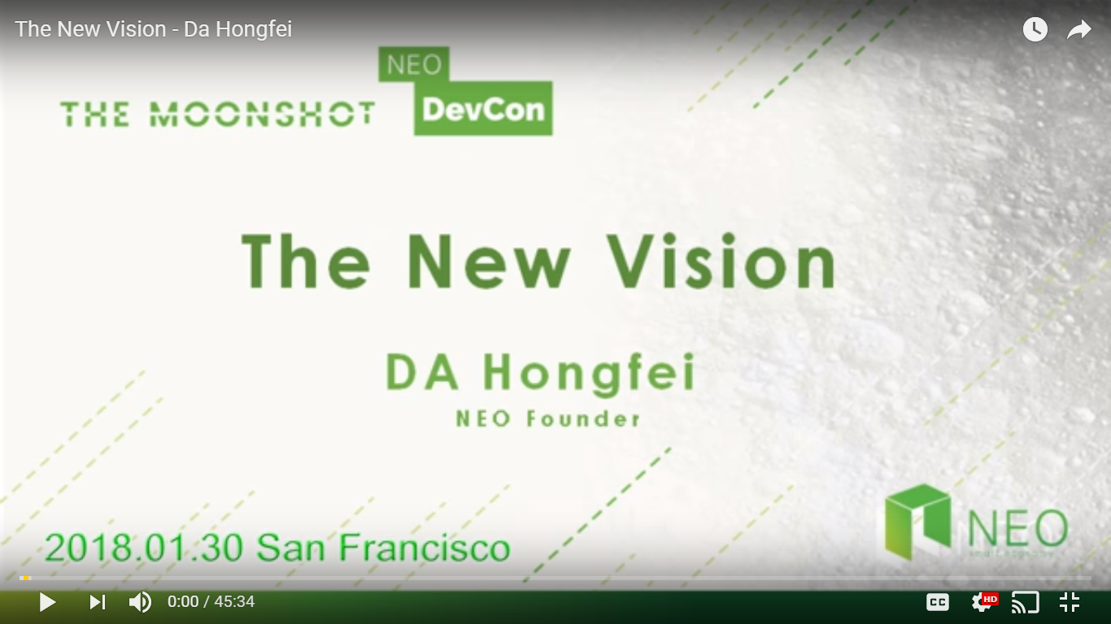

NEO Resources
General
NEO.org http://neo.org
NEO Tutorials (C#, Java, Python), API docs http://docs.neo.org
NEO DevCon “Th New Vision” Keynote by NEO Founder https://www.youtube.com/watch?time_continue=3&v=th7jZlmoZBc
Developers
NEO C# Developers Center of Excellence (neo-csharpcoe) https://github.com/mwherman2000/neo-csharpcoe/blob/master/README.md
Discord NEO Community (like Slack) https://discord.gg/gqCYeup
The NEO Project https://github.com/neo-project
City of Zion awesome-neo project: Developer Docs https://github.com/CityOfZion/awesome-neo/ #developer-documentation

Slide 74
NEO Blockchain C# Developers Center of Excellence https://github.com/mwherman2000/neo-csharpcoe
Founder: Michael Herman (neotoronto@outlook.com)
NEO Blockchain end-to-end, detailed guidance for .NET developers
Content purposely designed to help .NET developers ramp up and become productive more quickly
Repository for content presented at the NEO Blockchain Vancouver meetup group
Contents
NEO Blockchain Quick Start Guide for .NET Developers https://github.com/mwherman2000/neo-dotnetquickstart
NEO Blockchain Architecture Reference Model (ARM) for .NET Developers (neo-charm) https://github.com/mwherman2000/neo-charm
NEO Blockchain Vancouver https://github.com/mwherman2000/neo-windocs/tree/master/events/2018-NEO-Blockchain-Vancouver

Slide 75
NEO Blockchain Quick Start Guide for .NET Developers https://github.com/mwherman2000/neo-dotnetquickstart/blob/master/README.md
Pre-requisites and Recommendations
Download and install Visual Studio 2017 Community Edition integrated development environment (IDE)
Download and unpack NEO developer tool projects (source)
Coffee time: Wait for previous activities to complete
Install NeoContractPlugin Visual Studio extension
Build and test NEO developer tool projects (from source)
Download, install, and test Docker platform
Download and test NEO privatenet Docker container
Create and compile HelloWorld smart contract sample
Deploy and test the HelloWorld smart contract
Celebrate
Appendix A - Checklist
Appendix B - Roadmap
Appendix C - Reset NEO privatenet Environment: Container, Wallets, and Clients
Statistics
10 activities comprising 130 documented tasks (approximately)
140 screen shots (approximately)
7 batch files
2 JSON configuration files
1 C# code snippet

Slide 76
NEO Blockchain Architecture Reference Model (ARM) for .NET Developers (neo-charm) https://github.com/mwherman2000/neo-charm/blob/master/README.md

Slide 77
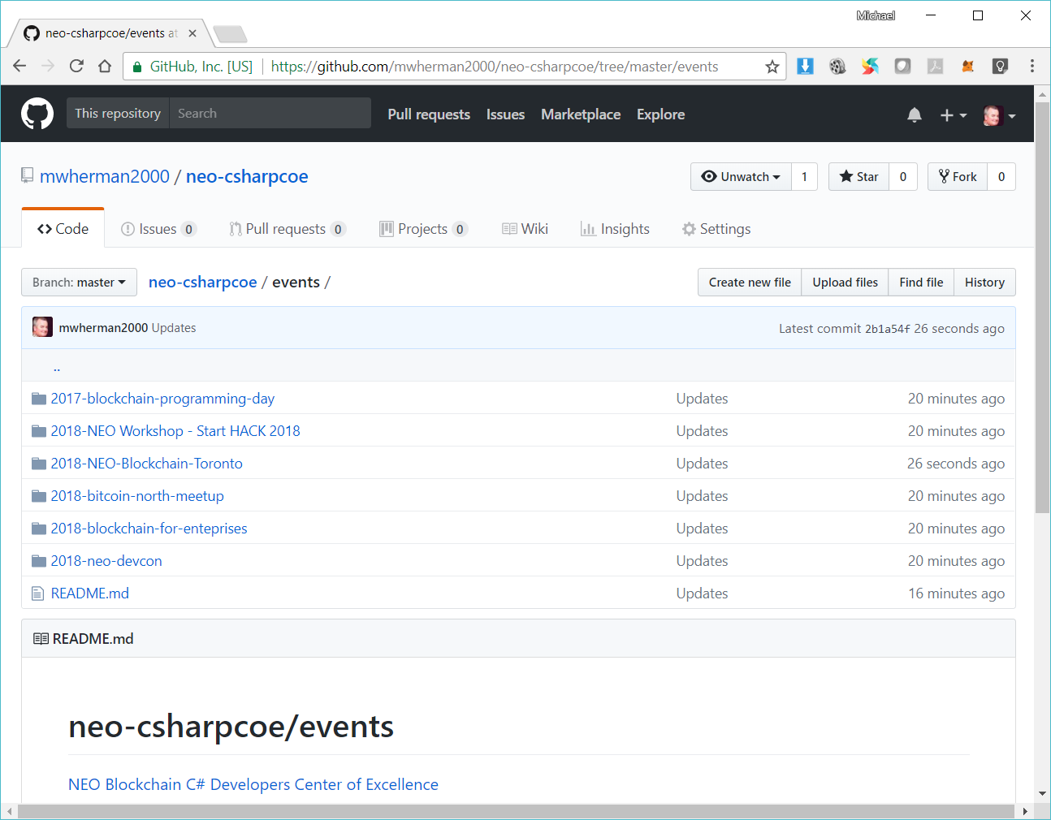
NEO Blockchain Vancouver / NEO Blockchain Toronto https://github.com/mwherman2000/neo-csharpcoe/tree/master/events

Slide 78
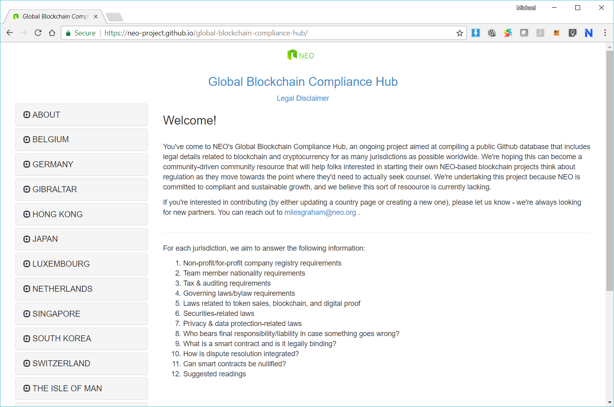

Slide 79
8. Next Steps

Slide 80

Next Steps
Join Discord https://discord.gg/gqCYeup / https://discord.gg/4TQujHj
Read through and contribute to NEO C# Developers Center of Excellence (neo-csharpcoe) https://github.com/mwherman2000/neo-csharpcoe/blob/master/README.md
Start with NEO Blockchain Quick Start Guide for .NET Developers https://github.com/mwherman2000/neo-dotnetquickstart/blob/master/README.md

Slide 81


Slide 82


Slide 83

I leave you with a challenge… Become part of the NEO Smart Economy
hyperonomy.com – digital intelligence (my blog)
https://hyperonomy.com/2018/01/24/tokenization-of-every-little-thing-elt/

Slide 84
Our Values as Neoxplorers
We operate like the NEO Blockchain
Decentralized
Community based
Consensus driven
Creators of value
Store of value (knowledge)
Transfer of value (training)
Multi-disciplinary
Multi-application
Multi-technology
We behave like the NEO Blockchain
Robust
Reliable
Transparent
Smart
Open
Non-discriminatory
Participatory
Diversity
Committed

Slide 85



Questions?
Happy St. Patrick’s Day
Neoxplorers!
Thank you for coming out this evening

Slide 86
Backup Slides

